Slide 1
Declaring Variables
Notes:
Schedule: Timing Topic
60 minutes Lecture
30 minutes Practice
90 minutes Total

Slide 2
Objectives
After completing this lesson, you should be able to
do the following:
Recognize the basic PL/SQL block and its sections
Describe the significance of variables in PL/SQL
Declare PL/SQL variables
Execute a PL/SQL block
Notes:
Lesson Aim
This lesson presents the basic rules and structure for writing and executing PL/SQL blocks of code. It also shows you how to declare variables and assign data types to them.
Instructor Note
Inform the class that iSQL*Plus is used throughout this course for the execution of demonstrations and lesson practices.

Slide 3
PL/SQL Block Structure
DECLARE (Optional)
  Variables, cursors, user-defined exceptions
BEGIN (Mandatory)
  SQL statements
  PL/SQL statements
EXCEPTION (Optional)
  Actions to perform when errors occur
END; (Mandatory)
…
DECLARE
…
BEGIN
…
EXCEPTION
END;
Notes:
PL/SQL Block Structure
PL/SQL is a block-structured language, meaning that programs can be divided into logical blocks. A PL/SQL block consists of up to three sections: declarative (optional), executable (required), and exception handling (optional). The following table describes the three sections:

Slide 4
Executing Statements and PL/SQL Blocks
DECLARE
v_variable VARCHAR2(5);
BEGIN
SELECT column_name
INTO v_variable
FROM table_name;
EXCEPTION
WHEN exception_name THEN
...
END;
…
DECLARE
…
BEGIN
…
EXCEPTION
END;
Notes:
Executing Statements and PL/SQL Blocks
Place a semicolon (;) at the end of a SQL statement or PL/SQL control statement.
When the block is executed successfully, without unhandled errors or compile errors, the message output should be as follows:
Section keywords DECLARE, BEGIN, and EXCEPTION are not followed by semicolons.
END and all other PL/SQL statements require a semicolon to terminate the statement.
You can string statements together on the same line, but this method is not recommended for clarity or editing.
Note: In PL/SQL, an error is called an exception.
With modularity you can break an application down into manageable, well-defined modules. Through successive refinement, you can reduce a complex problem to a set of simple problems that have easy-to-implement solutions. PL/SQL meets this need with program units, which include blocks, subprograms, and packages.

Slide 5
Block Types
Anonymous Procedure Function
[DECLARE]
BEGIN
--statements
[EXCEPTION]
END;
PROCEDURE name
IS
BEGIN
--statements
[EXCEPTION]
END;
FUNCTION name
RETURN datatype
IS
BEGIN
--statements
RETURN value;
[EXCEPTION]
END;
Notes:
Block Types
A PL/SQL program comprises one or more blocks. These blocks can be entirely separate or nested one within another. The basic units (procedures and functions, also known as subprograms, and anonymous blocks) that make up a PL/SQL program are logical blocks, which can contain any number of nested subblocks. Therefore, one block can represent a small part of another block, which in turn can be part of the whole unit of code.
Anonymous Blocks
Anonymous blocks are unnamed blocks. They are declared at the point in an application where they are to be executed and are passed to the PL/SQL engine for execution at run time. You can embed an anonymous block within a precompiler program and within iSQL*Plus or Server Manager. Triggers in Oracle Developer components consist of such blocks.
Subprograms
Subprograms are named PL/SQL blocks that can accept parameters and can be invoked. You can declare them either as procedures or as functions. Generally use a procedure to perform an action and a function to compute a value.
You can store subprograms at the server or application level. Using Oracle Developer components (Forms, Reports, and Graphics), you can declare procedures and functions as part of the application (a form or report) and call them from other procedures, functions, and triggers (see next page) within the same application whenever necessary.
Note: A function is similar to a procedure, except that a function must return a value.

Slide 6
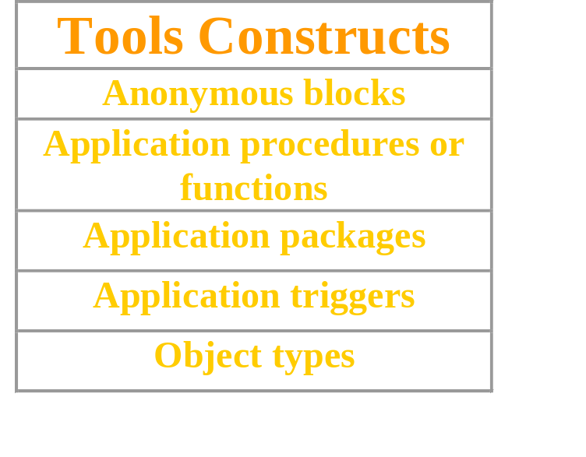
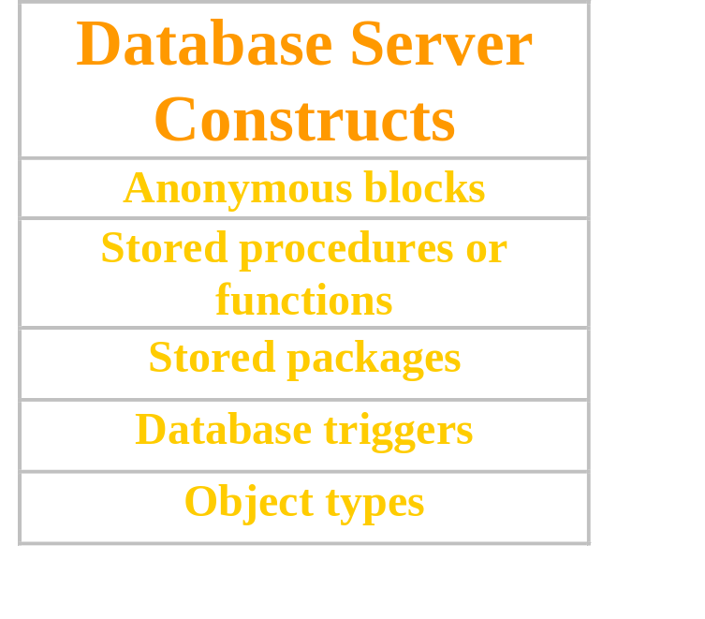
Program Constructs
…
DECLARE
…
BEGIN
…
EXCEPTION
END;
Notes:
Program Constructs
The following table outlines a variety of different PL/SQL program constructs that use the basic PL/SQL block. The program constructs are available based on the environment in which they are executed.

Slide 7
Use of Variables
Variables can be used for:
Temporary storage of data
Manipulation of stored values
Reusability
Ease of maintenance
Notes:
Use of Variables
With PL/SQL you can declare variables and then use them in SQL and procedural statements anywhere that an expression can be used. Variables can be used for the following:
Temporary storage of data: Data can be temporarily stored in one or more variables for use when validating data input and for processing later in the data flow process.
Manipulation of stored values: Variables can be used for calculations and other data manipulations without accessing the database.
Reusability: After they are declared, variables can be used repeatedly in an application simply by referencing them in other statements, including other declarative statements.
Ease of maintenance: When using %TYPE and %ROWTYPE (more information on %ROWTYPE is covered in a subsequent lesson), you declare variables, basing the declarations on the definitions of database columns. If an underlying definition changes, the variable declaration changes accordingly at run time. This provides data independence, reduces maintenance costs, and allows programs to adapt as the database changes to meet new business needs. More information on %TYPE is covered later in this lesson.

Slide 8
Handling Variables in PL/SQL
Declare and initialize variables in the declaration section.
Assign new values to variables in the executable section.
Pass values into PL/SQL blocks through parameters.
View results through output variables.
Notes:
Handling Variables in PL/SQL
Declare and Initialize Variables in the Declaration Section
You can declare variables in the declarative part of any PL/SQL block, subprogram, or package. Declarations allocate storage space for a value, specify its data type, and name the storage location so that you can reference it. Declarations can also assign an initial value and impose the NOT NULL constraint on the variable. Forward references are not allowed. You must declare a variable before referencing it in other statements, including other declarative statements.
Assign New Values to Variables in the Executable Section
In the executable section, the existing value of the variable is replaced with the new value that is assigned to the variable.
Pass Values Into PL/SQL Subprograms Through Parameters
There are three parameter modes, IN (the default), OUT, and IN OUT. Use the IN parameter to pass values to the subprogram being called. Use the OUT parameter to return values to the caller of a subprogram. And use the IN OUT parameter to pass initial values to the subprogram being called and to return updated values to the caller. We pass values into anonymous block via iSQL*PLUS substitution variables.
Note: Viewing the results from a PL/SQL block through output variables is discussed later in the lesson.

Slide 9
Types of Variables
PL/SQL variables:
  Scalar
  Composite
  Reference
  LOB (large objects)
Non-PL/SQL variables: Bind and host variables
Notes:
Types of Variables
All PL/SQL variables have a data type, which specifies a storage format, constraints, and valid range of values. PL/SQL supports four data type categories—scalar, composite, reference, and LOB (large object)—that you can use for declaring variables, constants, and pointers.
Scalar data types hold a single value. The main data types are those that correspond to column types in Oracle server tables; PL/SQL also supports Boolean variables.
Composite data types, such as records, allow groups of fields to be defined and manipulated in PL/SQL blocks.
Reference data types hold values, called pointers, that designate other program items. Reference data types are not covered in this course.
LOB data types hold values, called locators, that specify the location of large objects (such as graphic images) that are stored out of line. LOB data types are discussed in detail later in this course.
Non-PL/SQL variables include host language variables declared in precompiler programs, screen fields in Forms applications, and iSQL*Plus host variables.
For more information on LOBs, see PL/SQL User’s Guide and Reference, “Fundamentals.”
Instructor Note
Appendix D of this course covers REF cursors. You can use it in case of any queries.

Slide 10
Using iSQL*Plus Variables Within PL/SQL Blocks
PL/SQL does not have input or output capability of its own.
You can reference substitution variables within a PL/SQL block with a preceding ampersand.
iSQL*Plus host (or “bind”) variables can be used to pass run time values out of the PL/SQL block back to the iSQL*Plus environment.
Notes:
Using iSQL*Plus Variables Within PL/SQL Blocks
PL/SQL does not have input or output capability of its own. You must rely on the environment in which PL/SQL is executing to pass values into and out of a PL/SQL block.
In the iSQL*Plus environment, iSQL*Plus substitution variables can be used to pass run time values into a PL/SQL block. You can reference substitution variables within a PL/SQL block with a preceding ampersand in the same manner as you reference iSQL*Plus substitution variables in a SQL statement. The text values are substituted into the PL/SQL block before the PL/SQL block is executed. Therefore you cannot substitute different values for the substitution variables by using a loop. Only one value will replace the substitution variable.
iSQL*Plus host variables can be used to pass run-time values out of the PL/SQL block back to the iSQL*Plus environment. You can reference host variables in a PL/SQL block with a preceding colon. Bind variables are discussed in further detail later in this lesson.

Slide 11




Types of Variables
25-JAN-01
TRUE
“Four score and seven years ago
our fathers brought forth upon
this continent, a new nation,
conceived in LIBERTY, and dedicated
to the proposition that all men
are created equal.”
256120.08
Atlanta
Notes:
Types of Variables
The slide illustrates the following variable data types:
TRUE represents a Boolean value.
25-JAN-01 represents a DATE.
The photograph represents a BLOB.
The text of a speech represents a LONG.
256120.08 represents a NUMBER data type with precision and scale.
The movie represents a BFILE.
The city name, Atlanta, represents a VARCHAR2.
Instructor Note
Explain that in this lesson and course the terminology identifier and variable will be used interchangeably. Highlight that identifier is the name of the variable.

Slide 12
Declaring PL/SQL Variables
Syntax:
Examples:
identifier [CONSTANT] datatype [NOT NULL]
[:= | DEFAULT expr];
DECLARE
v_hiredate DATE;
v_deptno NUMBER(2) NOT NULL := 10;
v_location VARCHAR2(13) := 'Atlanta';
c_comm CONSTANT NUMBER := 1400;
Notes:
Declaring PL/SQL Variables
You must declare all PL/SQL identifiers in the declaration section before referencing them in the PL/SQL block. You have the option to assign an initial value to a variable. You do not need to assign a value to a variable in order to declare it. If you refer to other variables in a declaration, you must be sure to declare them separately in a previous statement.
In the syntax:
identifier : is the name of the variable.
CONSTANT : constrains the variable so that its value cannot change; constants must be initialized.
data type : is a scalar, composite, reference, or LOB data type. (This course covers only scalar, composite, and LOB data types.)
NOT NULL constrains the variable so that it must contain a value. (NOT NULL variables must be initialized.)
expr : is any PL/SQL expression that can be a literal expression, another variable, or an expression involving operators and functions.
Instructor Note
Explain that = and := are not the same.

Slide 13
Guidelines for Declaring PL/SQL Variables
Follow naming conventions.
Initialize variables designated as NOT NULL and CONSTANT.
Declare one identifier per line.
Initialize identifiers by using the assignment operator (:=) or the DEFAULT reserved word.
identifier := expr;
Notes:
Guidelines for Declaring PL/SQL Variables
Here are some guidelines to follow while declaring PL/SQL variables:
Name the identifier according to the same rules used for SQL objects.
You can use naming conventions—for example, v_name to represent a variable and c_name to represent a constant variable.
If you use the NOT NULL constraint, you must assign a value.
Declaring only one identifier per line makes code easier to read and maintain.
In constant declarations, the keyword CONSTANT must precede the type specifier. The following declaration names a constant of NUMBER subtype REAL and assigns the value of 50000 to the constant. A constant must be initialized in its declaration; otherwise, you get a compilation error when the declaration is elaborated (compiled).
v_sal CONSTANT REAL := 50000.00;
Initialize the variable to an expression with the assignment operator (:=) or, equivalently, with the DEFAULT reserved word. If you do not assign an initial value, the new variable contains NULL by default until you assign a value later. To assign or reassign a value to a variable, you write a PL/SQL assignment statement. You must explicitly name the variable to receive the new value to the left of the assignment operator (:=). It is good programming practice to initialize all variables.

Slide 14
Naming Rules
Two variables can have the same name, provided they are in different blocks.
The variable name (identifier) should not be the same as the name of table columns used in the block.
DECLARE
employee_id NUMBER(6);
BEGIN
SELECT employee_id
INTO employee_id
FROM employees
WHERE last_name = 'Kochhar';
END;
/
Adopt a naming convention for
PL/SQL identifiers:
for example, v_employee_id
Notes:
Naming Rules
Two objects can have the same name, provided that they are defined in different blocks. Where they coexist, only the object declared in the current block can be used.
You should not choose the same name (identifier) for a variable as the name of table columns used in the block. If PL/SQL variables occur in SQL statements and have the same name as a column, the Oracle server assumes that it is the column that is being referenced. Although the example code in the slide works, code that is written using the same name for a database table and variable name is not easy to read or maintain.
Consider adopting a naming convention for various objects that are declared in the DECLARE section of the PL/SQL block. Using v_ as a prefix representing variable avoids naming conflicts with database objects.
DECLARE
v_hire_date date;
BEGIN
...
Note: The names of the variables must not be longer than 30 characters. The first character must be a letter; the remaining characters can be letters, numbers, or special symbols.

Slide 15
Variable Initialization and Keywords
Assignment operator (:=)
DEFAULT keyword
NOT NULL constraint
Syntax:
Examples:
identifier := expr;
v_hiredate := '01-JAN-2001';
v_ename := 'Maduro';
Notes:
Variable Initialization and Keywords
In the syntax:
identifier is the name of the scalar variable.
expr can be a variable, literal, or function call, but not a database column.
The variable value assignment examples are defined as follows:
Set the identifier V_HIREDATE to a value of 01-JAN-2001.
Store the name “Maduro” in the V_ENAME identifier.
Variables are initialized every time a block or subprogram is entered. By default, variables are initialized to NULL. Unless you explicitly initialize a variable, its value is undefined.
Use the assignment operator (:=) for variables that have no typical value.
v_hire_date := '15-SEP-1999'
Note: This four-digit value for year, YYYY, assignment is possible only in Oracle8i and later. Previous versions may require the use of the TO_DATE function.
DEFAULT: You can use the DEFAULT keyword instead of the assignment operator to initialize variables. Use DEFAULT for variables that have a typical value.
v_mgr NUMBER(6) DEFAULT 100;
NOT NULL: Impose the NOT NULL constraint when the variable must contain a value.
You cannot assign nulls to a variable defined as NOT NULL. The NOT NULL constraint must be followed by an initialization clause.
v_city VARCHAR2(30) NOT NULL := 'Oxford'

Slide 16
Scalar Data Types
Hold a single value
Have no internal components
25-OCT-99
TRUE
“Four score and seven years
ago our fathers brought
forth upon this continent, a
new nation, conceived in
LIBERTY, and dedicated to
the proposition that all men
are created equal.”
256120.08
Atlanta
Notes:
Scalar Data Types
Every constant, variable, and parameter has a data type (or type), which specifies a storage format, constraints, and valid range of values. PL/SQL provides a variety of predefined data types. For instance, you can choose from integer, floating point, character, Boolean, date, collection, reference, and LOB types. In addition, This chapter covers the basic types that are used frequently in PL/SQL programs. Later chapters cover the more specialized types.
A scalar data type holds a single value and has no internal components. Scalar data types can be classified into four categories: number, character, date, and Boolean. Character and number data types have subtypes that associate a base type to a constraint. For example, INTEGER and POSITIVE are subtypes of the NUMBER base type.
For more information and the complete list of scalar data types, refer to PL/SQL User’s Guide and Reference, “Fundamentals.”
Instructor Note
Mention that the NUMBER, CHAR, and VARCHAR2 data types have subtypes. Additional base types are RAW and ROWID.

Slide 17
Base Scalar Data Types
CHAR [(maximum_length)]
VARCHAR2 (maximum_length)
LONG
LONG RAW
NUMBER [(precision, scale)]
BINARY_INTEGER
PLS_INTEGER
BOOLEAN
Notes:
Base Scalar Data Types

Slide 18
Base Scalar Data Types
DATE
TIMESTAMP
TIMESTAMP WITH TIME ZONE
TIMESTAMP WITH LOCAL TIME ZONE
INTERVAL YEAR TO MONTH
INTERVAL DAY TO SECOND
Notes:
Base Scalar Data Types (continued)

Slide 19
Scalar Variable Declarations
Examples:
DECLARE
v_job VARCHAR2(9);
v_count BINARY_INTEGER := 0;
v_total_sal NUMBER(9,2) := 0;
v_orderdate DATE := SYSDATE + 7;
c_tax_rate CONSTANT NUMBER(3,2) := 8.25;
v_valid BOOLEAN NOT NULL := TRUE;
...
Notes:
Declaring Scalar Variables
The examples of variable declaration shown on the slide are defined as follows:
v_job: variable to store an employee job title
v_count: variable to count the iterations of a loop and initialized to 0
v_total_sal: variable to accumulate the total salary for a department and initialized to 0
v_orderdate: variable to store the ship date of an order and initialize to one week from today
c_tax_rate: a constant variable for the tax rate, which never changes throughout the PL/SQL block
v_valid: flag to indicate whether a piece of data is valid or invalid and initialized to TRUE
Instructor Note
Have a different student explain each declaration in the example on the slide. Students will understand the concept better and it will also break the monotony.

Slide 20
The %TYPE Attribute
Declare a variable according to:
  A database column definition
  Another previously declared variable
Prefix %TYPE with:
  The database table and column
  The previously declared variable name
Notes:
The %TYPE Attribute
When you declare PL/SQL variables to hold column values, you must ensure that the variable is of the correct data type and precision. If it is not, a PL/SQL error will occur during execution.
Rather than hard coding the data type and precision of a variable, you can use the %TYPE attribute to declare a variable according to another previously declared variable or database column. The %TYPE attribute is most often used when the value stored in the variable will be derived from a table in the database. To use the attribute in place of the data type that is required in the variable declaration, prefix it with the database table and column name. If referring to a previously declared variable, prefix the variable name to the attribute.
PL/SQL determines the data type and size of the variable when the block is compiled so that such variables are always compatible with the column that is used to populate it. This is a definite advantage for writing and maintaining code, because there is no need to be concerned with column data type changes made at the database level. You can also declare a variable according to another previously declared variable by prefixing the variable name to the attribute.
Instructor Note
The %TYPE attribute has some overhead, in that a SELECT statement is issued against the database to obtain the data type. If the PL/SQL code is in a client tool, the SELECT must be executed each time the block is executed.

Slide 21
Declaring Variables with the %TYPE Attribute
Syntax:
identifier Table.column_name%TYPE;
Examples:
...
v_name employees.last_name%TYPE;
v_balance NUMBER(7,2);
v_min_balance v_balance%TYPE := 10;
...
Notes:
Declaring Variables with the %TYPE Attribute
Declare variables to store the last name of an employee. The variable v_name is defined to be of the same data type as the LAST_NAME column in the EMPLOYEES table. %TYPE provides the data type of a database column:
...
v_name employees.last_name%TYPE;
...
Declare variables to store the balance of a bank account, as well as the minimum balance, which starts out as 10. The variable v_min_balance is defined to be of the same data type as the variable v_balance. %TYPE provides the data type of a variable:
...
v_balance NUMBER(7,2);
v_min_balance v_balance%TYPE := 10;
...
A NOT NULL database column constraint does not apply to variables that are declared using %TYPE. Therefore, if you declare a variable using the %TYPE attribute that uses a database column defined as NOT NULL, you can assign the NULL value to the variable.

Slide 22
Declaring Boolean Variables
Only the values TRUE, FALSE, and NULL can be assigned to a Boolean variable.
The variables are compared by the logical operators AND, OR, and NOT.
The variables always yield TRUE, FALSE, or NULL.
Arithmetic, character, and date expressions can be used to return a Boolean value.
Notes:
Declaring Boolean Variables
With PL/SQL you can compare variables in both SQL and procedural statements. These comparisons, called Boolean expressions, consist of simple or complex expressions separated by relational operators. In a SQL statement, you can use Boolean expressions to specify the rows in a table that are affected by the statement. In a procedural statement, Boolean expressions are the basis for conditional control. NULL stands for a missing, inapplicable, or unknown value.
Examples
v_sal1 := 50000;
v_sal2 := 60000;
The following expression yields TRUE:
v_sal1 < v_sal2
Declare and initialize a Boolean variable:
DECLARE
v_flag BOOLEAN := FALSE;
BEGIN
v_flag := TRUE;
END;

Slide 23

Composite Data Types
TRUE 23-DEC-98 ATLANTA
PL/SQL table structure
PL/SQL table structure
1 SMITH
2 JONES
3 NANCY
4 TIM
1 5000
2 2345
3 12
4 3456
VARCHAR2
NUMBER
BINARY_INTEGER
BINARY_INTEGER
Notes:
Composite Data Types
A scalar type has no internal components. A composite type has internal components that can be manipulated individually. Composite data types (also known as collections) are of TABLE, RECORD, NESTED TABLE, and VARRAY types. Use the RECORD data type to treat related but dissimilar data as a logical unit. Use the TABLE data type to reference and manipulate collections of data as a whole object. Both RECORD and TABLE data types are covered in detail in a subsequent lesson. NESTED TABLE and VARRAY data types are covered in the Advanced PL/SQL course.
For more information, see PL/SQL User’s Guide and Reference, “Collections and Records.”

Slide 24
LOB Data Type Variables
Book
(CLOB)
Photo
(BLOB)
Movie
(BFILE)
NCLOB
Notes:
LOB Data Type Variables
With the LOB (large object) data types you can store blocks of unstructured data (such as text, graphic images, video clips, and sound wave forms) up to 4 gigabytes in size. LOB data types allow efficient, random, piecewise access to the data and can be attributes of an object type. LOBs also support random access to data.
The CLOB (character large object) data type is used to store large blocks of single-byte character data in the database in line (inside the row) or out of line (outside the row).
The BLOB (binary large object) data type is used to store large binary objects in the database in line (inside the row) or out of line (outside the row).
The BFILE (binary file) data type is used to store large binary objects in operating system files outside the database.
The NCLOB (national language character large object) data type is used to store large blocks of single-byte or fixed-width multibyte NCHAR unicode data in the database, in line or out of line.
Instructor Note
The NCLOB data type stores multibyte national character set character (NCHAR) data. Both fixed-width and variable-width character sets are supported. NCLOBs can store up to 4 gigabytes of character text data. NCLOBs have full transactional support. NCLOB value manipulations can be committed and rolled back.

Slide 25
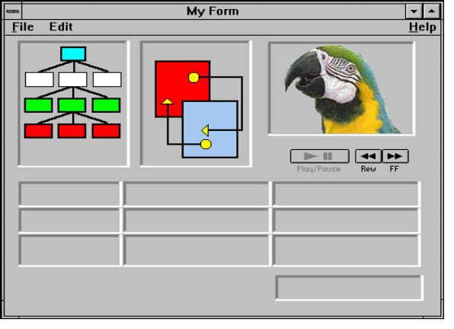
Bind Variables
O/S
Bind variable
Server
Notes:
Bind Variables
A bind variable is a variable that you declare in a host environment. Bind variables can be used to pass run-time values, either number or character, into or out of one or more PL/SQL programs. The PL/SQL programs use bind variables as they would use any other variable. You can reference variables declared in the host or calling environment in PL/SQL statements, unless the statement is in a procedure, function, or package. This includes host language variables declared in precompiler programs, screen fields in Oracle Developer Forms applications, and iSQL*Plus bind variables.
Creating Bind Variables
To declare a bind variable in the iSQL*Plus environment, use the command VARIABLE. For example, you declare a variable of type NUMBER and VARCHAR2 as follows:
VARIABLE return_code NUMBER
VARIABLE return_msg VARCHAR2(30)
Both SQL and iSQL*Plus can reference the bind variable, and iSQL*Plus can display its value through the iSQL*Plus PRINT command.

Slide 26
Using Bind Variables
To reference a bind variable in PL/SQL, you must prefix its name with a colon (:).
Example:
VARIABLE g_salary NUMBER
BEGIN
SELECT salary
INTO :g_salary
FROM employees
WHERE employee_id = 178;
END;
/
PRINT g_salary
Notes:
Printing Bind Variables
In iSQL*Plus you can display the value of the bind variable using the PRINT command.

Slide 27
Referencing Non-PL/SQL Variables
Store the annual salary into a iSQL*Plus host variable.
  Reference non-PL/SQL variables as host variables.
  Prefix the references with a colon (:).
:g_monthly_sal := v_sal / 12;
Notes:
Referencing Non-PL/SQL Variables
To reference host variables, you must prefix the references with a colon (:) to distinguish them from declared PL/SQL variables.
Example
This example computes the monthly salary, based upon the annual salary supplied by the user. This script contains both iSQL*Plus commands as well as a complete PL/SQL block.
VARIABLE g_monthly_sal NUMBER
DEFINE p_annual_sal = 50000
SET VERIFY OFF
DECLARE
v_sal NUMBER(9,2) := &p_annual_sal;
BEGIN
:g_monthly_sal := v_sal/12;
END;
/
PRINT g_monthly_sal
The DEFINE command specifies a user variable and assigns it a CHAR value. Even though you enter the number 50000, iSQL*Plus assigns a CHAR value to p_annual_sal consisting of the characters, 5,0,0,0 and 0.

Slide 28
DBMS_OUTPUT.PUT_LINE
An Oracle-supplied packaged procedure
An alternative for displaying data from a PL/SQL block
Must be enabled in iSQL*Plus with
SET SERVEROUTPUT ON
SET SERVEROUTPUT ON
DEFINE p_annual_sal = 60000
DECLARE
v_sal NUMBER(9,2) := &p_annual_sal;
BEGIN
v_sal := v_sal/12;
DBMS_OUTPUT.PUT_LINE ('The monthly salary is ' ||
TO_CHAR(v_sal));
END;
/
Notes:
DBMS_OUTPUT.PUT_LINE
You have seen that you can declare a host variable, reference it in a PL/SQL block, and then display its contents in iSQL*Plus using the PRINT command. Another option for displaying information from a PL/SQL block is DBMS_OUTPUT.PUT_LINE. DBMS_OUTPUT is an Oracle-supplied package, and PUT_LINE is a procedure within that package.
Within a PL/SQL block, reference DBMS_OUTPUT.PUT_LINE and, in parentheses, specify the string that you want to print to the screen. The package must first be enabled in your iSQL*Plus session. To do this, execute the iSQL*Plus SET SERVEROUTPUT ON command.
The example on the slide computes the monthly salary and prints it to the screen, using DBMS_OUTPUT.PUT_LINE. The output is shown below:
Instructor Note
Mention that the TO_CHAR function in the DBMS_OUTPUT.PUT_LINE is optional. It is included only for explicit conversion for better performance benefits.

Slide 29
Summary
In this lesson you should have learned that:
PL/SQL blocks are composed of the following sections:
  Declarative (optional)
  Executable (required)
  Exception handling (optional)
A PL/SQL block can be an anonymous
block, procedure, or function.
…
DECLARE
…
BEGIN
…
EXCEPTION
END;
Notes:
Summary
A PL/SQL block is a basic, unnamed unit of a PL/SQL program. It consists of a set of SQL or PL/SQL statements and it performs a single logical function. The declarative part is the first part of a PL/SQL block and is used for declaring objects such as variables, constants, cursors, and definitions of error situations called exceptions. The executable part is the mandatory part of a PL/SQL block, and contains SQL and PL/SQL statements for querying and manipulating data. The exception-handling part is embedded inside the executable part of a block and is placed at the end of the executable part.
An anonymous PL/SQL block is the basic, unnamed unit of a PL/SQL program. Procedures and functions can be compiled separately and stored permanently in an Oracle database, ready to be executed.

Slide 30
Summary
In this lesson you should have learned that:
PL/SQL identifiers:
  Are defined in the declarative section
  Can be of scalar, composite, reference, or LOB data type
  Can be based on the structure of another variable or database object
  Can be initialized
Variables declared in an external environment such as iSQL*Plus are called host variables.
Use DBMS_OUTPUT.PUT_LINE to display data from a PL/SQL block.
Notes:
Summary (continued)
All PL/SQL data types are scalar, composite, reference, or LOB type. Scalar data types do not have any components within them, whereas composite data types have other data types within them. PL/SQL variables are declared and initialized in the declarative section.
When a PL/SQL program is written and executed using iSQL*Plus, iSQL*Plus becomes the host environment for the PL/SQL program. The variables declared in iSQL*Plus are called host variables. Then the PL/SQL program is written and executed using, for example, Oracle Forms. Forms becomes a host environment, and variables declared in Oracle Forms are called host variables. Host variables are also called bind variables.
To display information from a PL/SQL block use DBMS_OUTPUT.PUT_LINE. DBMS_OUTPUT is an Oracle-supplied package, and PUT_LINE is a procedure within that package. Within a PL/SQL block, reference DBMS_OUTPUT.PUT_LINE and, in parentheses, specify the string that you want to print to the screen.

Slide 31
Practice 1 Overview
This practice covers the following topics:
Determining validity of declarations
Declaring a simple PL/SQL block
Executing a simple PL/SQL block
Notes:
Practice 1 Overview
This practice reinforces the basics of PL/SQL covered in this lesson, including data types, definitions of identifiers, and validation of expressions. You put all these elements together to create a simple PL/SQL block.
Paper-Based Questions
Questions 1 and 2 are paper-based questions.

